Slide 1


Welcome to DAMA Phoenix!
December 5, 2024
We will begin shortly.
Key Reminders:
If you are joining IN PERSON:
Sign In at Registration Desk
Pick up a Raffle Ticket
If you are joining ONLINE:
Sign In using your First and Last Name
Open Chat for messages and to ask questions
(Background slide courtesy of You Exec)

Slide 2
Agenda
8:30 – 9:00 Meet & Greet w/ Breakfast
9:00 – 9:15 Welcome / President’s Message
9:15 – 11:15 Presentation from James Anderson
11:15 – 11:25 Break
11:25 – 11:55 Networking/Breakout Group Discussions
11:55 – 12:00 Closing Comments & Raffle

Slide 3
Welcome/President’s Message

Slide 4
Welcome to DAMA Phoenix!
Returning Past Members
First Time Guests
2024 Individual Members
2024 Corporate Members
American Express
Arizona State University
Central Arizona Project
Salt River Project
State of Arizona
Town of Gilbert

Slide 5
Thank You Host Site & Future Sponsors!
Special Thank You to Today’s Host!
Housekeeping Items:
Restroom Locations
Wi-Fi
If your organization would be interested in hosting, please send an email to finance@dama-phoenix.org or contact Jeremiah Willett
We are also looking for sponsors for our 2024 sessions!
If your organization would be interested in sponsoring, please send an email to outreach@dama-phoenix.org or contact Sadie Hoberman

Slide 6
DAMA Phoenix
DAMA Phoenix is a non-profit, local chapter of data management professionals, operating as an affiliate of DAMA International
Vision: serve, promote, and bring together data management professionals who share the desire to optimize their corporate information resources to effectively meet the business objectives of their enterprise by:
Bringing together industry subject matter experts and local data management professionals throughout the year to network
Providing elevated training and certification opportunities
Enabling the sharing of best practices, lessons learned, and the latest innovative ideas and training in the data management industry
Websites
https://dama-phoenix.org/
https://www.linkedin.com/groups/DAMA-PHOENIX

Slide 7
DAMA Phoenix Membership Information
If you are interested in becoming an Individual or Corporate Member:
See our Membership page:
https://dama-phoenix.org/membership
Or contact Kathy Erickson
administration@dama-phoenix.org
First Time Attendance is Free
Calendar Year Annual Membership (Jan-Dec)
Annual Dues
Corporate Membership- $500
Individual Membership- $50
Join our mailing list to hear about upcoming events:
https://dama-phoenix.org/membership

Slide 8
DAMA Phoenix Board 2024
Role | Board Member | Email
President | Deron Hook | president@dama-phoenix.org
VP, Administration / Member Services | Kathy Erickson, Wells Fargo Sam Gladd, TEK Systems | administration@dama-phoenix.org
VP, Programs | Pete Stiglich, Data Principles Aakriti Agrawal | programs@dama-phoenix.org
VP, Logistics / Financial Services | Jeremiah Willett, Data Principles Judy Rounds, Nationwide E&S Specialty | finance@dama-phoenix.org
VP, Outreach | Sadie Hoberman, ASU | outreach@dama-phoenix.org
VP, Messaging | Senh Luu | messaging@dama-phoenix.org
Past President | Rafael Bustamante
If interested in serving, please contact us!

Slide 9
DAMA Phoenix Board Elections
DAMA Phoenix Board of Director positions are up for re-election by the last fiscal quarter of every two years
Voting occurs if there is more than 1 interested candidate for the role
The positions are staggered as follows:
Even Years (Next will be 2026) | Odd Years (Q4 2025)
• Messaging | • President
• Programs | • Financial Services & Logistics
• Member Services | • Outreach

Slide 10
2024 DAMA Phoenix Sessions Schedule
Speakers & Topics:
JSON Schema Modeling and Document Databases: April 4, 2024
Styles of Data Governance: June 18, 2024
Data Management and AI/ML Part 2: September 26, 2024
Cloud Data Architecture: James Anderson, December 5, 2024
Data architecture has changed from an often-centralized approach to a highly -distributed cloud driven approach where data may be spread across multiple-clouds or hybrid on-prem/cloud architectures, using a wide variety of modeling paradigms (relational, document, key value pair, graph, etc.) and technologies. In this session, we will discuss modern cloud native approaches to data architecture and their impact on data governance, management, and security.

Slide 11
2025 DAMA Phoenix Sessions Schedule
Potential Topics:
Q1 (February 11th / 13th)- TBD
Q2- TBD
Q3- TBD
Q4- TBD

Slide 12
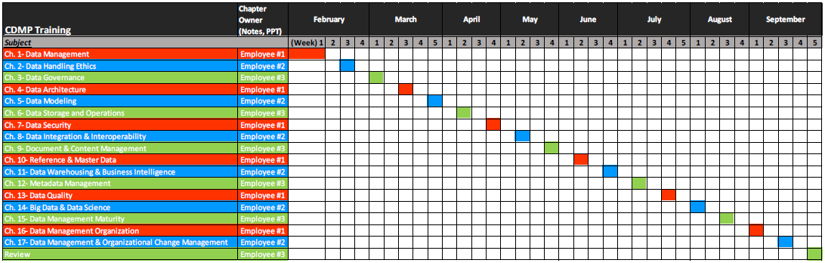
2025 DAMA Phoenix- NEW CDMP Study Group!

Slide 13
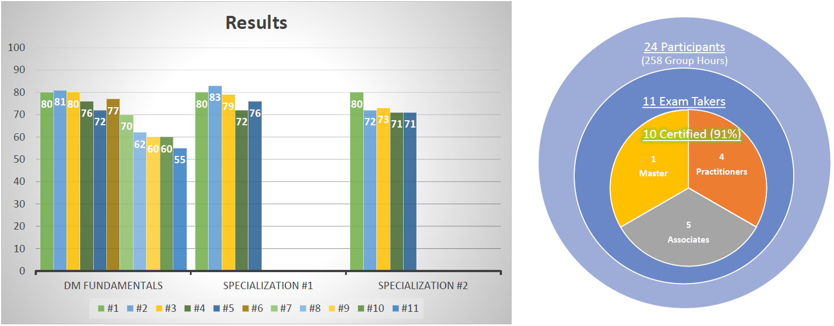
2025 DAMA Phoenix- NEW CDMP Study Group!
Notes:
More than doubled DAMA Indiana’s CDMPs… 125% increase.

Slide 14
2025 DAMA Phoenix- NEW CDMP Study Group!
If interested in participating:
Please email president@dama-phoenix.org or give Deron Hook your email address.
We will have a final last call for interested participants in our Q1 meeting (the week of February 10th)
We will then have our Kickoff Meeting the week of February 17th.

Slide 15

DAMA International
Mission:
DAMA-I is a not-for-profit, vendor-independent, global association of technical and business professionals dedicated to advancing the concepts and practices of information and data management
Goals:
Help Practitioners become more knowledgeable and skilled in the information and data management profession.
Influence practices, education and certification in the information and data management profession.
Support DAMA members and their organizations to address their information and data management needs.
Form alliances with other organizations with similar principles to strengthen the profession.
Website: https://www.dama.org/

Slide 16

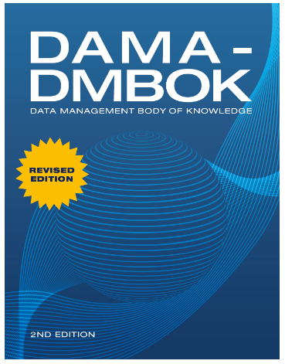
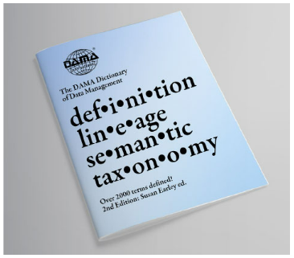

DAMA International Offers
Certification
Certified Data Management Professional (CDMP)
Events
International/Regional Data Conferences Such as EDW & DGIQ
Best Practice Resources
Data Management Body of Knowledge (DAMA-DMBOK2)
DAMA Dictionary of Data Management (2nd edition)
Training
Pay for Learning Plans and Courses
Membership
$50 membership fee; but NOT reciprocal with local chapters
Benefits include access to resources and discounts to the above

Slide 17


DAMA International Events
2024 Events:
Data Governance & Information Quality (DGIQ) East
Washington, D.C.; December 9 – 13
CDMP PIYP Event
Website: https://www.dataversity.net/data-governance-and-information-quality-dgiq-east/
2025 Events:
Data Modeling Zone (DMZ)
Phoenix, AZ; March 4 – 6
20% Discount Coupon Code: DAMA-Phoenix-DMZ-20
Website: https://technicspub.com/dmz/
DGIQ + EDW
Anaheim, CA; May 5 – 9
CDMP PIYP Event
Call for Presentations by Dec. 16, 2024

Slide 18
Cloud Data Architecture
James Anderson

Slide 19
Introducing Today’s Speaker
James Anderson is the Head of Data Cloud Architecture at Snowflake, focused on helping customers across the globe maximize the value of their data assets, and drive innovation through collaboration. James has run multiple technical teams over his 4 years at Snowflake, helping customers from all industries successfully architect their Snowflake deployments to support their broader enterprise data strategy. Prior to joining Snowflake, James was the Head of Platform Architecture for Slalom, building Modern Data Stacks for clients across all major cloud technologies.

Slide 20
Break
10 minutes

Slide 21
Networking & Breakout Group Discussions

Slide 22
Networking & Breakout Group Discussion Q’s
Introductions of each group member (Name, Company, Role, Years Experience, Favorite Dessert, etc.)
What is your biggest takeaway from today’s topic?
What is something you learned or would like to learn more because of today’s topic?
What is your experience with today’s topic?
What is your biggest problem that you are facing in your organization when it comes to data management?
Could today’s topic help with this issue?

Slide 23
Closing Comments/Raffle

Slide 24
Thank You!

