Slide 1




DAMA Phoenix – April 2024
JSON Schema and document databases

Slide 2


JSON SCHEMA AND DOCUMENT DATABASES
Subayai Inc created in 2006
  Multiple Fortune 500 clients
Founder:
  Started in software at age 12
  Helped grow Ferguson Enterprises from $600m to $12B in less than ten years.
  Implemented first electronic trade with Kohler (yes – the toilet company… among other things)
Presenter:
Darrell Teague
President
darrell.teague@subayai.com
Presentation and materials copyright Subayai Inc, 2024 All Rights Reserved
No unauthorized redistribution or derivative works permitted.

Slide 3
JSON SCHEMA AND DOCUMENT DATABASES
Fun Facts About Subayai Inc.
Like some baby names, few can pronounce it (速い).
After exhausting names in English and Spanish about software we could trademark, we switched to Japanese.
速い translates to “Agile” but this was before design became a bad word.
We helped design Loans by Marcus… but we were not alone.
Subayai built search/schema for 2k locations and 3.2 million products.
Major Client Data Projects (that you never heard of):
Redesigned and helped build largest US ISP customer self-service systems (37 million subscribers).
Designed and built Quote Management System for largest durable goods distributor.
  Consulting by Len Silverston of the
  Data Model Resource Book series
Designed and built secure email extension (MTA) – resold on the Microsoft Store.

Slide 4


JSON SCHEMA AND DOCUMENT DATABASES
Intended Audience / Pre-requisites (but don’t panic)
Data Management Professionals (you know who you are)
Software System Architects / Leads
Business Analysts / Process Managers
About Data Governance:
A managed approach to data that defines usability, integrity, security and definitions based on standards and policies that control and monitor usage over time.
Effective data governance ensures that data is consistent, universally and unambiguously understood and trustworthy in-flight and at-rest.
Data Governance in the early days was controlled by the DBAs.
  Established rational model for how business viewed the domain.
  Now fragments are at the API level.
… and if you have questions, you can always call or write.

Slide 5
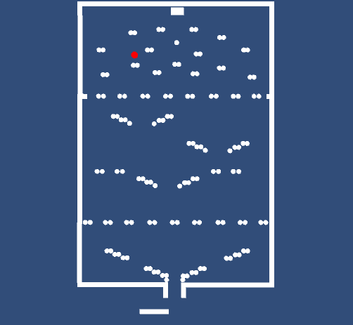
JSON SCHEMA AND DOCUMENT DATABASES
(video on bad data that ruined a county – true story)
Data Eventually Gets Combined
https://www.youtube.com/watch?v=k4gj_RdtKCw
Key Take Aways:
“Fail Fast” in software applies to data.
  Validate against models early in process.
Data are never an island.
  Set: 1, 3, 5 … average is 3.
  Add one bad point of 100 and it moves to 27.25 .. Even if range was really 1-10 !
Ends up in reports, summaries somewhere.

Slide 6
JSON SCHEMA AND DOCUMENT DATABASES
About JSON Schema:
Successor specification to XML Schema
  What JSON is to XML in modeling
  Supports logical data model (LDM)
  Richly supports nested hierarchy
  Provides for efficient validation:
    Faster than coding in APIs
    One model for all components
    Similar to RDBMS constraints
About Document Databases:
Faster, Looser DB Storage Engine
  Built on “No SQL” position
  Largely ‘document’ stores with keys
    Strong JSON support
  Proprietary (no query standard)
  Some with high-availability models
    MongoDB Atlas
    Cassandra

Slide 7
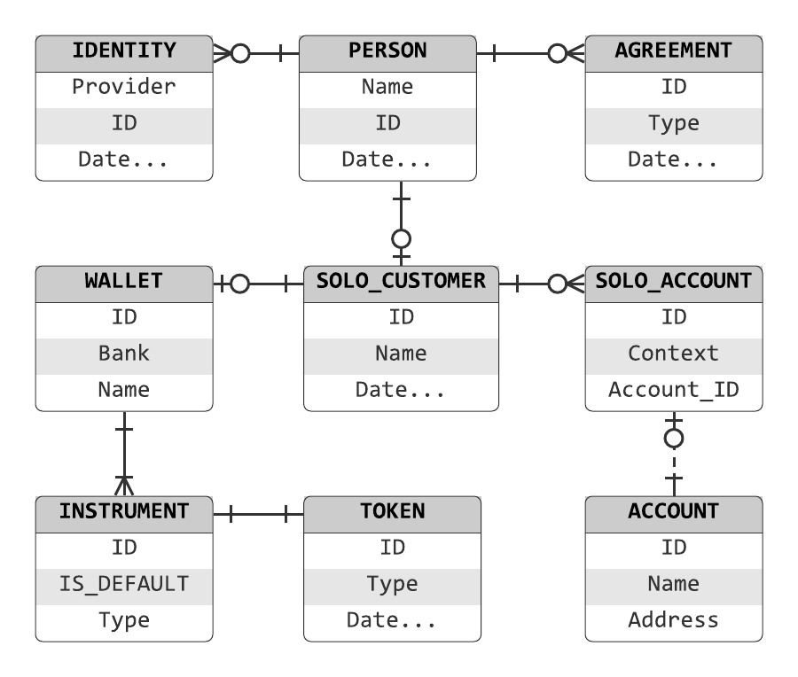
JSON SCHEMA AND DOCUMENT DATABASES
NoSQL Databases and JSON
The landscape discussion would not be complete without a treatment about the demise of RDBMS and data modeling.
Prior to Agile, Micro-Services and more, data models used to be managed and maintained both logically and physically … largely in relational database systems and with tools (Rational Rose, et al) and canonical forms like XML that could reflect hierarchy.
Old World
<xml>
<header>
<customer>
<name>…
<dob>…
</xml>
New World
{
“name” : “homer”,
“age” : 22
}
GET /customer

Slide 8
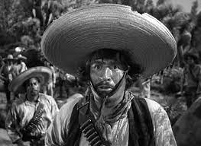
JSON SCHEMA AND DOCUMENT DATABASES
JSON is better than XML
Yes, it is the best thing since sliced bread… smaller, faster, lighter, easier – we love it. All the cool kids use JSON.
And.. JSON Schema has (finally) caught up to XML Schema.
  Business domain can be modeled in JSON.
Logical data models and validators remain important tools.
Models? We don’t need no stinkin models!
Fun Fact: JSON is not J.Lo’s son … but JavaScript Object Notation - though now it really has no dependency on JavaScript.
SELECT *
FROM [JSON]
WHERE [Data] > 0
No records found.
What is JSON Schema?
A modeling language for JSON – just as XML Schema was for XML. JSON can be made to comply with a model.

Slide 9
JSON SCHEMA AND DOCUMENT DATABASES
A Brief History on JSON Schema and where it is today…
While JSON itself was spawned out of JavaScript circa year 2000, JSON Schema lagged far behind with the first draft specification put out in 2007.
To this day, this created a culture in which JSON was commonly generated by systems but with little to no definition outside of random examples.
  This put the burden of understanding what to expect out of APIs on developers, with nary a thought of a coherent system-wide data model.
  JSON Schema provides the tools, supported by almost every popular programming language and many document-databases (MongoDB et al), to create a rich and constraint-driven system comparable with an RDBMS.

Slide 10
JSON SCHEMA AND DOCUMENT DATABASES
JSON Schema and the IETF Process (is broken)…
JSON Schema (https://json-schema.org) latest version is 2020-12 (Draft 9).
  This is supported by the Open API Specification v3.1 (2021).
    “Data types in the OAS are based on the types supported by the JSON Schema Specification Draft 2020-12. “
  Latest version NOT supported by MongoDB – lagging at Draft 4 (2013).
    There is much consternation over the decade long lapse in updates.
Programming languages from Java to C#/.NET, products like Altova XMLSpy and others support JSON Schema 2020-12.

Slide 11
JSON SCHEMA AND DOCUMENT DATABASES
As a manager, an analyst or architect … what does this mean?
Developers largely are driving forward every day in the Agile world so… embrace the change and use JSON Schema Draft 9 from 2020 (already four years old but with all of the needed features).
But what about MongoDB only supporting JSON Schema Draft 4?
We will discuss MongoDB validation options and other strategies that will not tie down organizations to the most restrictive vendor.

Slide 12
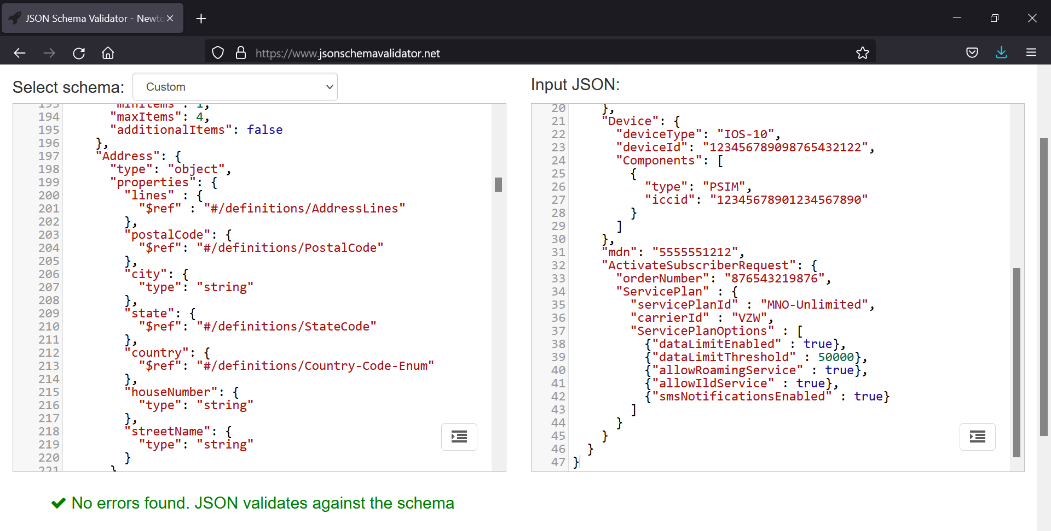
JSON SCHEMA AND DOCUMENT DATABASES
If your organization is not developing JSON Schemas and validating at runtime … start!
Schemas are efficient and a critical aspect of data governance controls.

Slide 13
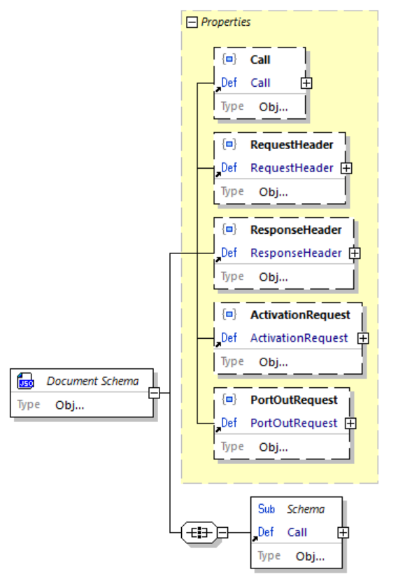
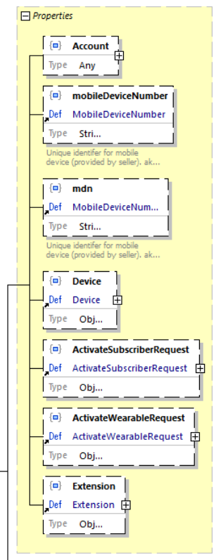
JSON SCHEMA AND DOCUMENT DATABASES
Many tools are available for managing models, schemas and translating to and from Avro, JSON Schema and more.
Altova XML Spy (actually an excellent JSON Schema tool), Hackolade, etc.
"ActivationRequest": {
"billCycleDayOfMonth" : 15,
"Account": {
"type": "COMMERCIAL",
"billingSystemId": "amdocs",
"accountId": "987654321123456",
"BillingAddress": {
"lines": [
"123 Main Street",
"Apt 1A"
],
"postalCode": "00105",
"city": "Kansas City",
"state": "MO"
} ,
"Device": {
"deviceType": "IOS-10",
"deviceId": "123456789098765432122",
"Components": [
{
"type": "PSIM",
"iccid": "123456789012345"
}
]}…

Slide 14
JSON SCHEMA AND DOCUMENT DATABASES
Questions and Discussion on JSON Schema, Tools, Standards

Slide 15

JSON SCHEMA AND DOCUMENT DATABASES
Java code sample for one field:
@Size(
min = 5,
max = 14,
message = "The author email '${validatedValue}' must be between {min} and {max} characters long"
)
private String authorEmail;
JSON Schema vs Agile Development Teams
For better or worse, Agile is here to stay with the scale of controls tipped toward business development teams.
Still, through careful and deliberate management and discussion, development teams will appreciate being relieved of the burden of tedious validation coding.
Using JSON Schema - Architects, Analysts and even the business themselves (in providing a logical data model to start with) can define a coherent organization-wide model at the right layer of abstraction that accelerates vs slows down software development teams.
The above multiplied one hundred times for one hundred fields. Then repeated for services that use the same data elements (usually with different rules between projects / teams).
Not reusable for different languages / platforms for the same data.

Slide 16
JSON SCHEMA AND DOCUMENT DATABASES
Better Development with JSON Schemas
Just as with test-driven-development (TDD), data-driven development is faster/better/cheaper in the long run.
JSON Schema elements can be easily pulled together to create new ‘views’ of aggregates and denormalized elements as needed.
  This is the compromise : Allow teams to mix/match elements as needed to meet changing business needs.
  However, where truly new data elements or composites are created, work back through governance process (rarer case).
Allow teams to develop schemas from existing elements.
  Balance between governance and development speed.
  Restricting this creates bottleneck in development process.
  Data governance groups must be responsive to Agile sprints.
  Use an ‘extension’ (any) element to bridge the difference.
    Governance team reviews on periodic basis.
Java validation code (one time):
JSONObject jsonSchema = new JSONObject (
new JSONTokener(
JSONSchemaTest.class.getResourceAsStream(
"/schema.json")));
JSONObject jsonSubject = new JSONObject(
new JSONTokener(
JSONSchemaTest.class.getResourceAsStream(
"/product.json")));
Schema schema = SchemaLoader.load(jsonSchema);
schema.validate(jsonSubject);
The above sample loads the JSON Schema – just do once and keep in memory (faster).
Then for any data received, via any means, validate the payload against the schema.
  Process takes 10s of milliseconds.
Error handling is built-in (message auto-generated pointing to any errors).

Slide 17
JSON SCHEMA AND DOCUMENT DATABASES
JSON Schema Abstraction
As organizations wade into JSON Schema (and even those who are hip deep already) – an important consideration is to use the very powerful abstraction constructs available in JSON Schema.
Done right, this allows for cases common in new endeavors, Agile teams looking for flexibility in requirements, etc – by threading the needle between very stiff models and arbitrary data that cannot be validated at all.
"InsuranceDocument": {
"type": "object",
"properties": {
…
},
"additionalProperties" : false,
"required": [
"document"
],
"oneOf" : [
{"allOf" : [
{"required" : ["contract"]}
]},
{"allOf" : [
{"required" : ["policy"]}
]}
]
}

Slide 18
JSON SCHEMA AND DOCUMENT DATABASES
JSON Schema Abstraction
"InsuranceDocument": {
"type": "object",
"properties": {
…
},
"additionalProperties" : false,
"required": [
"document"
],
"oneOf" : [
{"allOf" : [
{"required" : ["contract"]}
]},
{"allOf" : [
{"required" : ["policy"]}
]}
]
}
Some required ‘document’ (HREF) ‘reference’ to a thing … could be a PDF – almost anything.
The ‘structured data’ part, which can be either a ‘contract’ or ‘policy’ object type … that is yet further abstracted as needed.
Differentiated but has to be one or the other and not some random data.

Slide 19
JSON SCHEMA AND DOCUMENT DATABASES
JSON Schema Abstraction
{
"schemaVersion": "1.2",
"document": {
"documentGUID": "1234-9999-XXXX-9876,
"mediaType": "application/pdf"
},
"policy": {
"policyId": "23427456-01",
"currencyCode": "USD",
"termStartDateTime": "2022-12-31T15:57:00Z",
"termEndDateTime": "2023-12-31T15:57:00Z",
"grossPremiumAmount": {
"currencyCode": "AAA",
"amount": 0.1
}
}
}…
Some required ‘document’ (HREF) ‘reference’ to a thing … could be a PDF – almost anything.
The ‘structured data’ part, which can be either a ‘contract’ or ‘policy’ object type … that is yet further abstracted as needed.
Differentiated but has to be one or the other and not some random data.

Slide 20
JSON SCHEMA AND DOCUMENT DATABASES
JSON Schema Abstraction
Schema versioning is critical.
  Each JSON (instance) document must carry a field indicating the version of the schema it supports.
Schemas can (and will) evolve over time so consider starting off more abstract.
  As requirements/constraints become more clear, more specific schema elements (that conform to the original abstraction) can be created.
"Address": {
"type": "object",
"properties": {
…
},
"additionalProperties" : false,
"required": [
"city",
"state",
"postalCode"
],
"oneOf" : [
{"allOf" : [
{"required" : ["houseNumber"]},
{"required" : ["streetName"]}
]},
{"allOf" : [
{"required" : ["lines"]}
]}
]
}

Slide 21
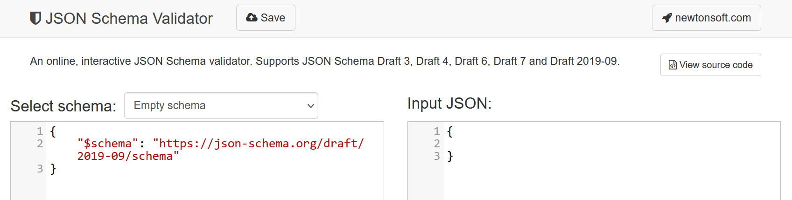
JSON SCHEMA AND DOCUMENT DATABASES
JSON Schema Tools
https://www.jsonschemavalidator.net
FREE: Copy/Paste JSON Schema on left, JSON on right – instantly shows validation success/error.

Slide 22
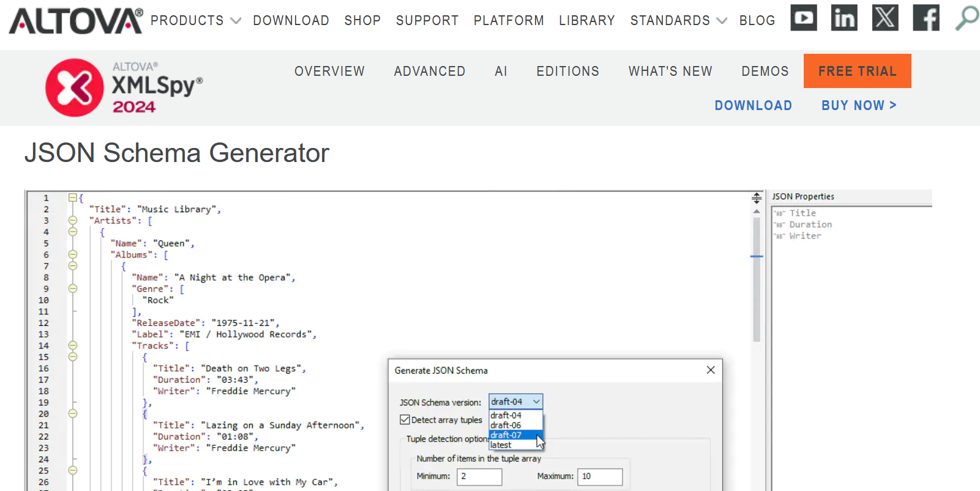
JSON SCHEMA AND DOCUMENT DATABASES
JSON Schema Tools
https://www.altova.com/xmlspy-xml-editor/json_schema_editor
No product endorsement here … just some references to tools Subayai and our clients use.
There are many others including Hackolade, Visual Studio and more.

Slide 23
JSON SCHEMA AND DOCUMENT DATABASES
Learning JSON Schema
https://json-schema.org/
The home for JSON Schema is surprisingly well put together for a specification.
Clear, concise examples, starting with basics and getting into more advanced topics.
JSON Schema is very much like a programming language.
Just as we had to learn the ‘Structured Query Language’ (SQL) and the Data Definition Language’ (DDL) of various databases - so too must one learn JSON Schema.
Pro Tip: Someone (preferrable with a backup in case the first fellow wins the lottery) in your IT / data organization should be a principal data architect steeped in JSON Schema.

Slide 24
JSON SCHEMA AND DOCUMENT DATABASES
Questions and Discussion on JSON Schema
Why it Matters and What it is For
How it can speed development while improving data quality
Importance of tools and learning the language

Slide 25
JSON SCHEMA AND DOCUMENT DATABASES
Tying JSON Schema into the Organization and Architecture
https://www.openapis.org/
https://swagger.io/specification
Ivory Tower approaches to introducing and using JSON Schema will inevitably fail.
Creating a win-win for managers, analysts, reporting and development teams is critical.
Self-documenting APIs are important. The Open API fully supports JSON Schema.
  A popular supporting and related tool for development teams is Swagger.
Pro Tip: Data Architects need to embed with development teams, analysts and reporting groups at various times.
In this way, teams will stay engaged, the data-model (schema) can evolve and yet be controlled somewhat centrally as a coherent dictionary for the whole organization.

Slide 26
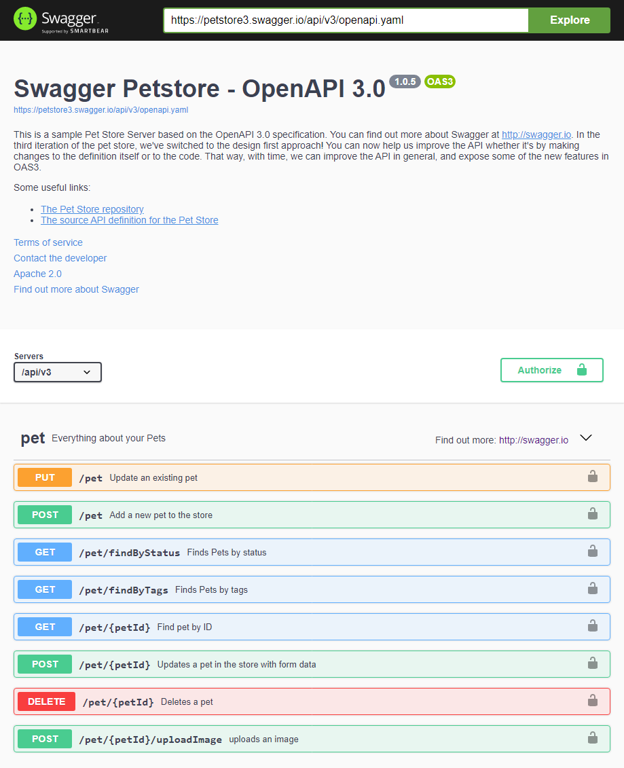
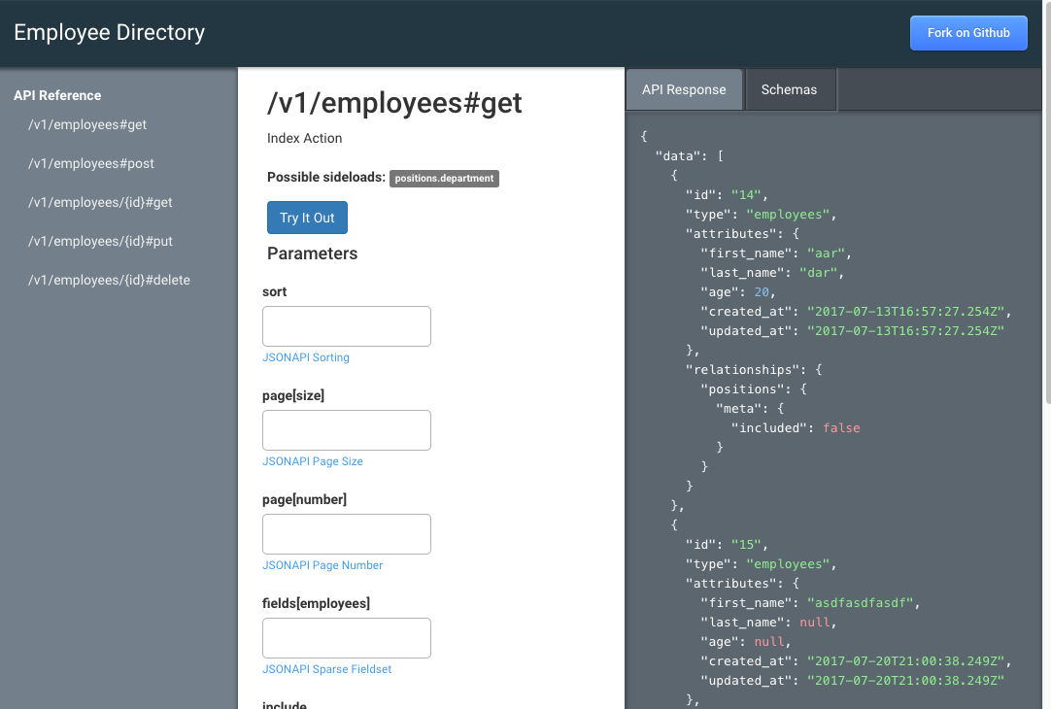
JSON SCHEMA AND DOCUMENT DATABASES

Slide 27
JSON SCHEMA AND DOCUMENT DATABASES
A Model for Maintaining JSON Schemas
JSON Schemas need to exist at 3+ levels:
  As discrete, reusable data elements:
    Ex: “addressLine” with min/max properties, etc.
  As small common components:
    Ex: “requestHeader” with meta-data, abstraction.
  As ‘documents’ or views at top-level.
  Ex: “PurchaseOrder” made up of components.
Denormalized single JSON Schema of the ‘document’ level, made up of the piece-parts available to teams.
Components and Documents must be versioned.
  Breaking-changes require new version!
  API versions tied to schema document versions.
Document
(v1.2)
Composite A
(v1.1)
Element 1
Element 2
Composite B
(v2.9)
Element 1
Element 5
Element 3

Slide 28


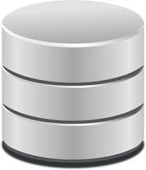

JSON SCHEMA AND DOCUMENT DATABASES
A Model for Maintaining JSON Schemas
Data governance and development team collaboration.
  Data folks try to be responsive to business needs.
  Development folks try to reuse data elements.
  Meet to discuss changes.
    Development team can create new Documents and/or Composites where needed.
    Both groups check-in schemas, do versioning.
    Be careful of breaking changes!
  Use extensibility section (any) judiciously.
  Periodically meet and review new Documents and Composites – collapse and refine over time.
Data Mgmt
Developer
SCHEMA
JSON Schema Repository
JSON Schema
Web Server

Slide 29
JSON SCHEMA AND DOCUMENT DATABASES
A Model for Using JSON Schemas
Once versioned JSON Schema are in a repository, they can be used by applications.
  Micro-services (language/platform neutral).
  Messaging systems (Kafka et al).
  Bulk data transfers.
Only use denomalized schema (one file – no external refs).
Applications load schemas into memory on startup.
Validation is done at run-time:
  Receiving POST requests from REST services.
  Receiving messages (Kafka) or data (sFTP etc).
REST API versioning associated with schema version.
  Ex: API v5 uses Product schema v6.1
Client / Publisher
Service / Receiver
validates
SCHEMA
(load on startup)
JSON Schema Repository
JSON Schema
Web Server

Slide 30
JSON SCHEMA AND DOCUMENT DATABASES
Questions and Discussion on Audience Schema Management
Tools Used
Application Integration
Conversions from other formats (Avro, etc)

Slide 31
JSON SCHEMA AND DOCUMENT DATABASES
A Model for Versioning
Documents are the top-level JSON Schema.
Documents are made up of any number of Components and individual Elements.
Components may contain other Components.
Components and Documents must be versioned.
Once published, versioned Schemas are immutable.
If a Component or Document has a required child (Element or Component) added, removed or renamed – that part version must be incremented. This may cascade:
  While the original Document version is unaffected, to use a new Component version the Document version must also be incremented.
Data Mgmt
Developer
Document
(v1.2)
Composite A
(v1.1)
Element 1
Element 2
Composite B
(v2.9)
SCHEMA
Element 1
Element 5
Element 3
JSON Schema Repository
JSON Schema
Web Server

Slide 32
JSON SCHEMA AND DOCUMENT DATABASES
A Model for Versioning
REST API Version mapped 1-to-1 to Document Version.
The API payload (GET or POST) is part of the contract.
  Removing, adding or changing any Component or Element of the Document is a breaking change.
  Since the Document is the Payload … the version of the Document is linked to the REST API version.
    This is directly expressed in API documentation.
REST APIs usually include the version in the URL Path.
  Ex: GET /customer/v1
  where: “customer” is the top-level entity and “v1” is the version of the API, which corresponds to ‘some’ version of the Document schema… but need not be the same.
Client / Publisher
Service / Receiver
validates
Document
(v1.2)
Composite A
(v1.1)
Element 1
Element 2
SCHEMA
Composite B
(v2.9)
Element 1
(load on startup)
Element 5
Element 3
JSON Schema Repository
JSON Schema
Web Server

Slide 33
JSON SCHEMA AND DOCUMENT DATABASES
Questions and Discussion on Schema and API Versioning
Strategies Used
Impact of using a single changing version
Minor / Major Version Naming Conventions

Slide 34
JSON SCHEMA AND DOCUMENT DATABASES
Document (NoSQL) Databases
Circa 1998 and into 2007 (10Gen) and finally 2013 (MongoDB) … “NoSQL” and ‘document’ databases sought to address the explosion of massive data sets (Amazon, Google et al) via geometric internet growth.
Developer-driven, these databases are NOT relational.
Rather, they largely exist to store somewhat arbitrary blobs of data (via JSON) with simple indexes to query on ‘lists’ of simple data-types (customers, products, etc).
“Collections” liken to ‘tables’ but do not relate to one another at all.
Easy to store and retrieve data and achieve large data storage scale without having to learn SQL or ODBC/JDBC connectivity standards.
  While wildly popular, NoSQL systems have no standards for connectivity or query language - every NoSQL database is proprietary.
Client / Publisher
NoSQL DB

Slide 35
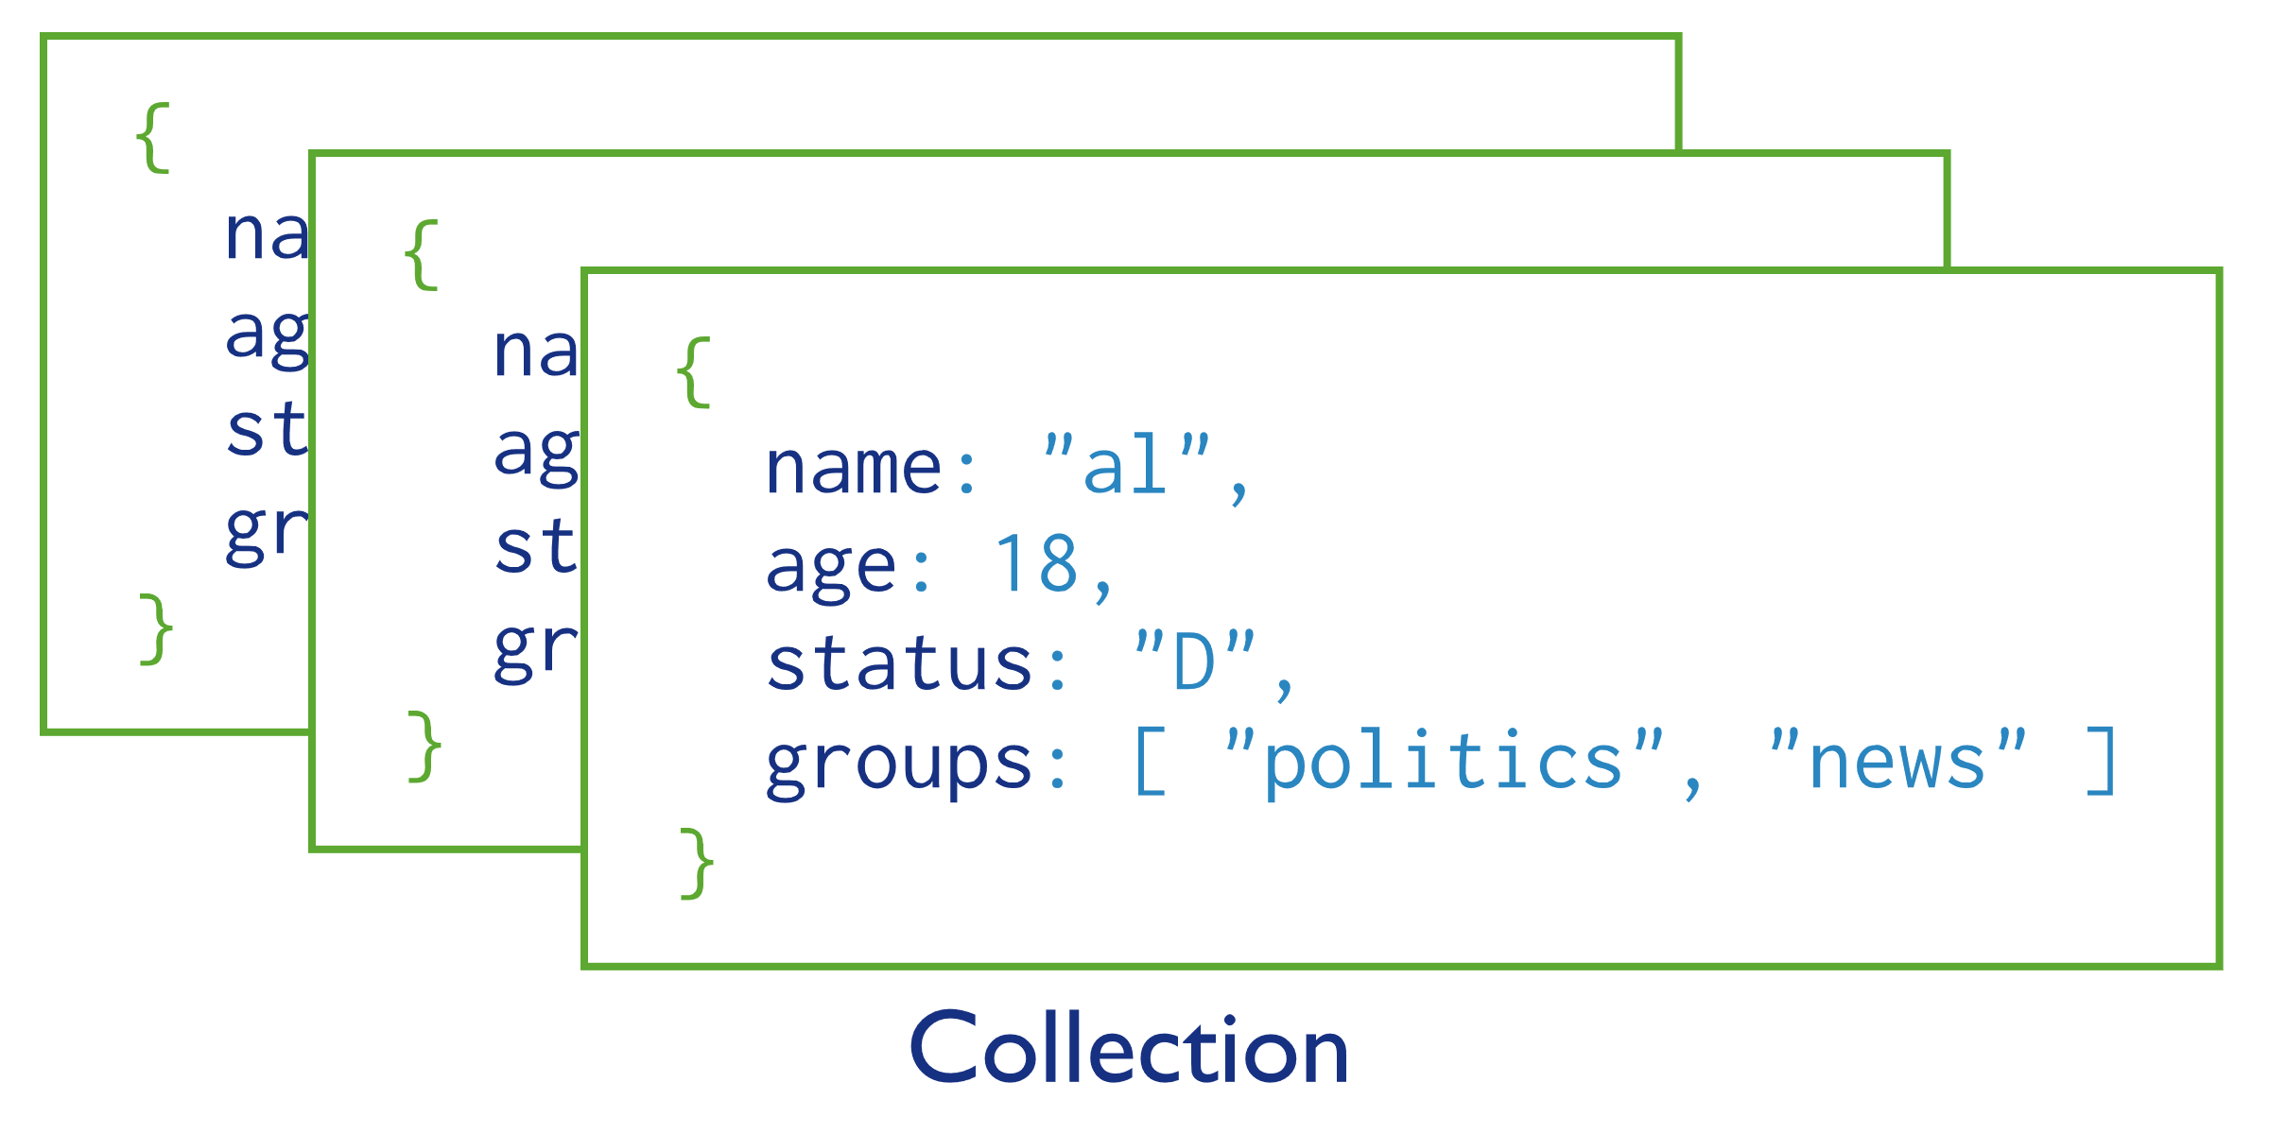
JSON SCHEMA AND DOCUMENT DATABASES
Document (NoSQL) Databases - Collections
“Collections” are like RDBMS ‘tables’ in a sense, nested inside a ‘database’.
However, they are not related in any way.
Collections can however be indexed for efficient retrieval by a given field.
In the example on the right (from a major NoSQL DB vendor), an index can be created on a field like ‘age’ and then queries written against it.
  Pro Tip: Pay careful attention to the modeling anti-pattern from the vendor using ‘age’ versus birth-date!

Slide 36
JSON SCHEMA AND DOCUMENT DATABASES
Document (NoSQL) Databases – Connections, Indexes and Queries (oh my!)
Every NoSQL database (MongoDB et al) has its own proprietary:
  Connection API (per language)
  Data-definition-language (DDL) for creating ‘collections’ and indexes
  Query language
Every DB has constraints/limits so take care to enforce them at the lowest-common denominator via JSON Schema (min, max, enumerations).
Real Constraint Example
It is not uncommon to see a generic ‘string’ type definition for nearly every field in a NoSQL (JSON) document. This is a bad practice that should be avoided. String types for example in Java can be over 2-million bytes!
In a minor software release by a Fortune company, developers inserted a field over 1024 bytes that was indexed. This exceeded a MongoDB limit on indexed fields and caused a complete system failure.

Slide 37
JSON SCHEMA AND DOCUMENT DATABASES
Document (NoSQL) Databases – Schema Best Practices
Good JSON Schema design will ensure better NoSQL performance.
Judicious and simple use of the right data-types (string, number, etc), min/max limits and enumerations will provide field-validation safe-guards.
Improves queries and reporting out of the database so that integrators for full-text search systems, BI reporting systems and more know what to expect.
Good JSON Schema Practice
"CountryCode": {
"type": "string",
"minLength": 2,
"maxLength": 2,
"pattern": "[A-Z]{2}$",
"description": "ISO 3166-1 alpha-2
code. https://en.wikipedia.org/wiki/ISO_3 166-1_alpha-2"
}

Slide 38
JSON SCHEMA AND DOCUMENT DATABASES
Document (NoSQL) Databases – Inserting JSON documents/records
https://www.mongodb.com/docs/manual/core/views/join-collections-with-view/
db.inventory.insertMany( [
{ prodId: 100, price: 20, quantity: 125 }, {…}
])
db.orders.insertMany( [
{ orderId: 201, custid: 301, prodId: 100, numPurchased: 20 },
{…}
])

Slide 39
JSON SCHEMA AND DOCUMENT DATABASES
Document (NoSQL) Databases – Join Query across Collections
To effectively create a “join” across Collections (using a MongoDB example) – one must first create a ‘view’.
This creates a query-only reference between the collections. It does not create an RDBMS kind of ‘referential integrity’ that would constrain inserts.
db.createView( "sales", "orders", [ {
$lookup: {
from: "inventory",
localField: "prodId",
foreignField: "prodId",
as: "inventoryDocs"
} }, { $project: {
_id: 0,
prodId: 1,
orderId: 1,
numPurchased: 1,
price: "$inventoryDocs.price" } },
{ $unwind: "$price" } ] )
Remember: This ain’t your grandfather’s SQL. DDL and query syntax, language, transactions and connection management are specific to the given NoSQL vendor (or abstraction tool provider).

Slide 40
JSON SCHEMA AND DOCUMENT DATABASES
Document (NoSQL) Databases – Join Query Results
Query:
db.sales.aggregate ( [ {
$group: {
_id: "$prodId",
amountSold: {
$sum: {
$multiply: [
"$price","$numPurchased" ]
} }
}
} ] )
Result:
[
{ _id: 102, amountSold: 90 },
{ _id: 101, amountSold: 150 },
{ _id: 103, amountSold: 1105 },
{ _id: 100, amountSold: 600 }
]

Slide 41
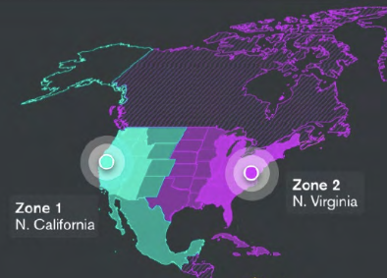
JSON SCHEMA AND DOCUMENT DATABASES
Document (NoSQL) Databases – The Good
NoSQL or ‘document’ databases like MongoDB, Cassandara and more excel at high-availability, low-cost and scalability.
MongoDB Atlas for example offers multi-region (as in cross-country or cross-global) transparent high-availability.
  A hurricane taking out AWS on the Eastern Seaboard for example can be mitigated automatically.

Slide 42
JSON SCHEMA AND DOCUMENT DATABASES
Document (NoSQL) Databases – even more Good
NoSQL or ‘document’ databases are relatively inexpensive both at the enterprise and lower scale project / system level.
Via many cloud-native options (MongoDB Atlas for example supported by multiple providers beyond AWS) … these database types can scale easily into the millions-and-millions of records.
Insert/Update and single record retrieval performance tends to be highly optimized.
Development teams, especially those familiar with specific databases, find integrations easy.
Simple query and index performance usually good (but there are bad practices and limits).
MongoDB Atlas supports built-in full-text search capability.
  Downside however is that this is then proprietary and customers are locked in.
Most document databases support solid ‘streaming’ and trigger type features.

Slide 43
JSON SCHEMA AND DOCUMENT DATABASES
Document (NoSQL) Databases – The Bad
NoSQL (document) databases are proprietary to the extreme:
  Connectivity (no ODBC/JDBC standards – though there are converter tools)
  DDL (language frameworks, tools, GUIs, CLIs are all proprietary – lock in)
  Query Language, indexing and constraints/options require training on specific database.
Collections are not ‘tables’:
  The good of lossy ease of inserts/updates offset by having no referential-integrity.
  JSON Schema will only apply to each ‘collection’ individually.
    A good enterprise-wide JSON Schema (model) can ensure the same ‘field’ in different ‘collections’ is in effect the same ‘kind’ of thing however.
  MongoDB only supports nearly a decade old version of JSON Schema for validation.
    Some of the most important features of JSON Schema are in the latest Draft 9 version.

Slide 44
JSON SCHEMA AND DOCUMENT DATABASES
Document (NoSQL) Databases – The Ugly
From languages to frameworks, toolsets and command-line-interfaces (CLIs)… once a NoSQL database is selected, it is infeasible to move to a different one.
  While MongoDB Atlas for example has some great architecture, scaling and other features, once data are there and teams locked into the platform – moving off is nearly impossible.
JSON Schema versioning within these systems is not strictly possible.
  A collection can for example, via an $or construct in validation, reference multiple schemas. However, it is not known which a given JSON document conforms to.
MongoDB does not really support an enterprise-usable version of JSON Schema.
‘Triggers’ are all of the ‘after’ type and thus ‘before insert/update’ constructs not possible.

Slide 45
JSON SCHEMA AND DOCUMENT DATABASES
Questions and Discussion on NoSQL/Document Databases
Use and definitions
Differentiating between RDBMS features
What are the good/bad/ugly considerations

Slide 46

JSON SCHEMA AND DOCUMENT DATABASES
Architectural and Design Process – JSON Schema
Define a logical data model.
Translate into JSON Schema (Draft 9).
1
2
3
Design/Implement
Schema Repo
Versioning
Validators
Integrations
Reporting

Slide 47
JSON SCHEMA AND DOCUMENT DATABASES
JSON Schema Design – Best Practices
Name and put version numbers in schema/s.
  Use a source-code revision-control-system just like software for JSON Schemas (GIT et al).
Use a (hyperlinked) schema repository – read access by developers, API tools, integrators.
  Note: The schema repo is NOT the NoSQL or document database for JSON.
    However, a document database is a perfect use-case for storing schemas themselves.
    JSON Schema is, after all, JSON text !
Use abstract JSON Schema ‘object’ types as containers – use reasonably loose constraints.
  Use $or, $anyOf (list), ‘object’ extension types and related constructs at top-level.
    Allow development teams to then ‘fill in’ more concrete details inside.
    Review and refine these over time, versioning schemas as you go.

Slide 48
JSON SCHEMA AND DOCUMENT DATABASES
JSON Storage Architectural Considerations
Just as not every project is a perfect candidate for Agile, NoSQL databases have limits.
  If a system has a strong need for referential integrity, an RDBMS is a better option.
  Collections, as the name implies, are best for ‘lists of (simple)’ things:
    Public non-registered user information (loose, non-identifying fields).
    Unstructured meta-data for things outside organizational control:
      Products referenced but maybe not marketed/sold by the company.
      Public lists of things on the Internet like ISO standard tables (countries, etc).
      Unstructured (text) content from suppliers, customers or governmental orgs.
Document databases are actually not ideal for ‘documents’ like PDFs, MSWord, etc.
  Instead, use a binary-large-object (BLOB) repository like AWS S3 (includes meta-data).

Slide 49



JSON SCHEMA AND DOCUMENT DATABASES
Base Storage Architecture - JSON Schemas and Data
RDBMS
Store and Version Schemas in GitHub
Provide to App Servers via Schema Server
Validate via App Servers
Store and Serve appropriate data (and/or NoSQL)
Use full-text search vs queries
NoSQL
BI / Reporting / Integration
Search
Engine
App Server
Schema
Server

Slide 50
JSON SCHEMA AND DOCUMENT DATABASES
JSON Schema Architectural Rationale
JSON is a concise and full-featured canonical data format (messaging, services, etc).
  JSON is well supported by tools, programming languages, databases and more.
JSON alone however, without JSON Schema, is a recipe for systemic problems:
  Data Quality, Consistency and Definition (what is it?)
  Logical Use (reporting, integration, APIs)
JSON Schemas need to be managed:
  Versioned in a SCM.
  Made available to service systems (APIs), developers, QAs, analysts, BI systems, etc.
JSON validation must be fast and accurate (by app-servers and messaging systems on insert).
  Cannot effectively be used inside NoSQL DB (poor version support, only one of many tiers).

Slide 51

JSON SCHEMA AND DOCUMENT DATABASES
JSON Schema Architectural Rationale – rounding things out…
NoSQL databases are okay for simple indexes and queries.
  However, as systems grow, performance can suffer greatly against large queries.
  Individual record lookups and well-partitioned data have good query performance.
Full-text search engines are built-for-purpose to ingest from (various) sources.
  This can include both RDBMS and NoSQL sources.
  Search engines have faster performance, are more relevant, scalable over time.
  Decoupled from data sources (eventually consistent) and highly available (HA).
    Easier to make a high-performance full-text search engine HA than an RDBMS.
Oh my this looks super complicated.
Can’t we just skip some of these parts and lump these functions together?

Slide 52
JSON SCHEMA AND DOCUMENT DATABASES
JSON Schema Architectural Rationale – starting small.
At a minimum, realize the moment a JSON Schema (data model) is created and ‘published’ for the group at-large for any purpose/use … it is permanent (for at least a few versions).
  Customers, internal teams, integrators will start to use it, weave it into APIs, reports.
Thus at least build in versioning and provide (read-only) access to the versioned schemas.
  This is where the ‘Schema Server’ part comes in – they have to be exposed somehow.
The next most useful thing to do is ensure dev teams use the schemas for validation.
  Stop hand-coding programming language specific field-level validation (Java, Python, etc).
    It becomes almost immediately out-of-sync with the defined schema (costly).
  Since validation will happen at inception (when received), there is no need to use any NoSQL database validation layer – especially given the poor version support in MongoDB.
Start with (very) abstract schemas that do not allow *anything* but are flexible.

Slide 53
JSON SCHEMA AND DOCUMENT DATABASES
Document Databases and Tools for Jump-starting JSON Use
MongoDB Atlas and other document databases have tools for data analysis.
Take advantage of JSON-to-schema auto-generators and use schemas to generate QA data.
Use free online tools to create JSON schema, instance (JSON) samples and validate.
Realize also that RDBMS systems can work a lot like document databases:
BLOB type table
ID (primary key, int)
BLOB (JSON)
Meta-Data table
Key (varchar, enum)
Value (varchar)
ID (foreign key, int)

Slide 54
JSON SCHEMA AND DOCUMENT DATABASES
Final Thoughts
JSON Schema is a full-on programming language like SQL (but closer to XML Schema).
  There are other related specifications too like JSON Path libraries for Java, C#, etc.
  It will take a dedicate small set of analysts and/or developers to manage properly.
    This may be a side-job for someone at your org but they must master JSON Schema.
Get the ‘bones’ of a JSON Schema based architecture together early.
  Start winning hearts, minds and budgets through less hard-coding and fewer errors and Zoom calls trying to figure out what data are.
  Build versioning in Day-1.
    A large Fortune company failed to do this and the very next project suffered greatly.
Get architectural help from a pro (Subayai comes to mind…) to get started.
  The hard parts of creating a good baseline schema and architecture are only paid once.

Slide 55
JSON SCHEMA AND DOCUMENT DATABASES
Questions and Discussion on Architecture
When to use RDBMS vs NoSQL Databases
Architectural Components
Design Considerations and Rationale

