Slide 1


DAMA Phoenix presentation - 2022
Data governance and management patterns with real time services

Slide 2


Data governance meets agile and micro services
Subayai Inc created in 2006
  Multiple Fortune 500 clients
Founder:
  Started in software at age 12
  Helped grow Ferguson Enterprises from $600m to $12B in less than ten years.
  Implemented first electronic trade with Kohler (yes – the toilet company… among other things)
Presenter:
Darrell Teague
President
darrell.teague@subayai.com
Presentation and materials copyright Subayai Inc, 2022 All Rights Reserved
No unauthorized redistribution or derivative works permitted.

Slide 3
Data governance meets agile and micro services
Fun Facts About Subayai Inc.
Like some baby names, few can pronounce it (速い).
After exhausting names in English and Spanish about software we could trademark, we switched to Japanese.
速い translates to “Agile” but this was before design became a bad word.
We helped design Loans by Marcus… but we were not alone.
Subayai built search/schema for 2k locations and 3.2 million products.
Major Client Data Projects (that you never heard of):
Redesigned and helped build largest US ISP customer self-service systems (37 million subscribers).
Designed and built Quote Management System for largest durable goods distributor.
  Consulting by Len Silverston of the
  Data Model Resource Book series
Designed and built secure email extension (MTA) – resold on the Microsoft Store.

Slide 4


Data governance meets agile and micro services
Intended Audience / Pre-requisites (but don’t panic)
Data Management Professionals (you know who you are)
Software System Architects / Leads
Business Analysts / Process Managers
About Data Governance:
A managed approach to data that defines usability, integrity, security and definitions based on standards and policies that control and monitor usage over time.
Effective data governance ensures that data is consistent, universally and unambiguously understood and trustworthy in-flight and at-rest.
Data Governance in the early days was controlled by the DBAs.
  Established rational model for how business viewed the domain.
  Now fragments are at the API level.
… and if you have questions, you can always call or write.

Slide 5
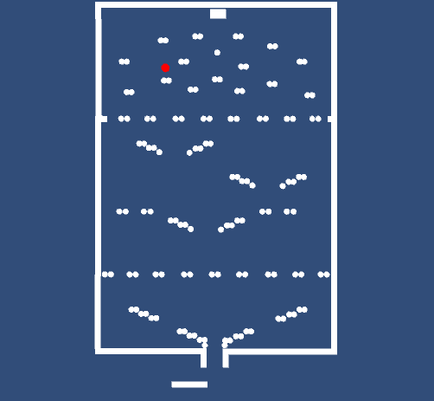
Data governance meets agile and micro services
(video on bad data that ruined a county – true story)
Data Eventually Gets Combined
https://www.youtube.com/watch?v=k4gj_RdtKCw
Key Take Aways:
“Fail Fast” in software applies to data.
  Validate against models early in process.
Data are never an island.
  Set: 1, 3, 5 … average is 3.
  Add one bad point of 100 and it moves to 27.25 .. Even if range was really 1-10 !
Ends up in reports, summaries somewhere.

Slide 6
Data governance meets agile and micro services
About Agile:
At the turn of the century (surprisingly just 20ish years ago), the Agile Manifesto was famously penned (okay - typed) … ushering in the era of MySpace pages and eventually the system formerly known as Facebook.
Agile/Scrum and more recently the Scaled Agile Framework (SAFe) largely removed design from software development.
  Focus on always adding business value.
  Working code over documentation.
  Short, fixed-length software releases.
  Small teams aligned with business groups.
About Micro Services:
Term first used around 2005 and showcased in 2011 as a design pattern.
Promotes largely REST-based (web) friendly and simple, one purpose calls using JSON structures.
  GET /customer
  POST /transaction
Data models pushed forward to the API layer.
  No longer was a centrally governed database/team defining data in/out.
  Data fragments, inconsistent entities and denormalized views are the new normal.

Slide 7
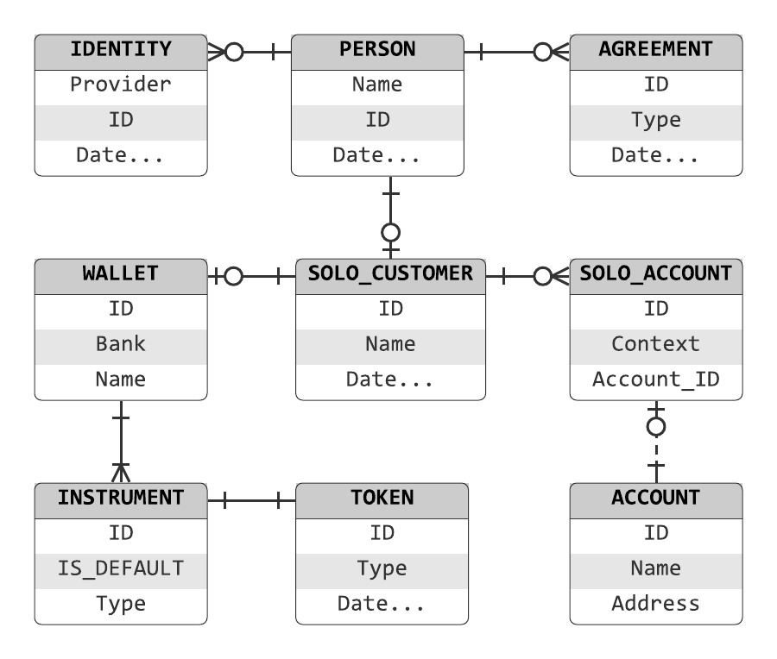
Data governance meets agile and micro services
NoSQL Databases and JSON
The landscape discussion would not be complete without a treatment about the demise of RDBMS and data modeling.
Prior to Agile, Micro-Services and more, data models used to be managed and maintained both logically and physically … largely in relational database systems and with tools (Rational Rose, et al) and canonical forms like XML that could reflect hierarchy.
Old World
<xml>
<header>
<customer>
<name>…
<dob>…
</xml>
New World
{
“name” : “homer”,
“age” : 22
}
GET /customer

Slide 8

Data governance meets agile and micro services
JSON is better than XML
Yes, it is the best thing since sliced bread… smaller, faster, lighter, easier – we love it. All the cool kids use JSON.
And.. JSON Schema has (finally) caught up to XML Schema.
  Business domain can be modeled in JSON.
Logical data models and validators remain important tools.
Models? We don’t need no stinkin models!
Fun Fact: JSON is not J.Lo’s son … but JavaScript Object Notation - though it now has absolutely nothing to do with JavaScript.
SELECT *
FROM [JSON]
WHERE [Data] > 0
No records found.
What is JSON Schema?
A modeling language for JSON – just as XML Schema was for XML. JSON can be made to comply with a model.

Slide 9
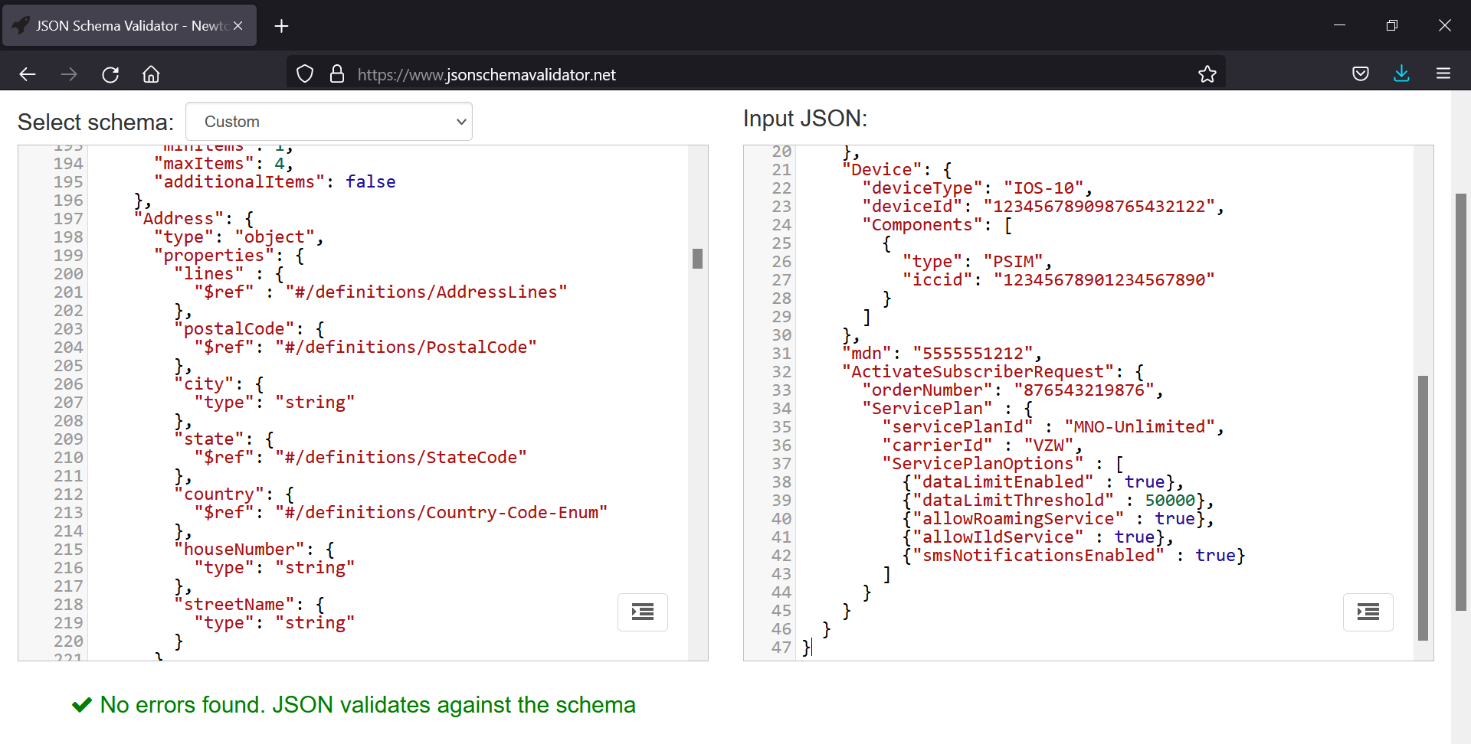
Data governance meets agile and micro services
If your organization is not developing JSON Schemas and validating at runtime … start!
Schemas are efficient and a critical aspect of data governance controls.

Slide 10
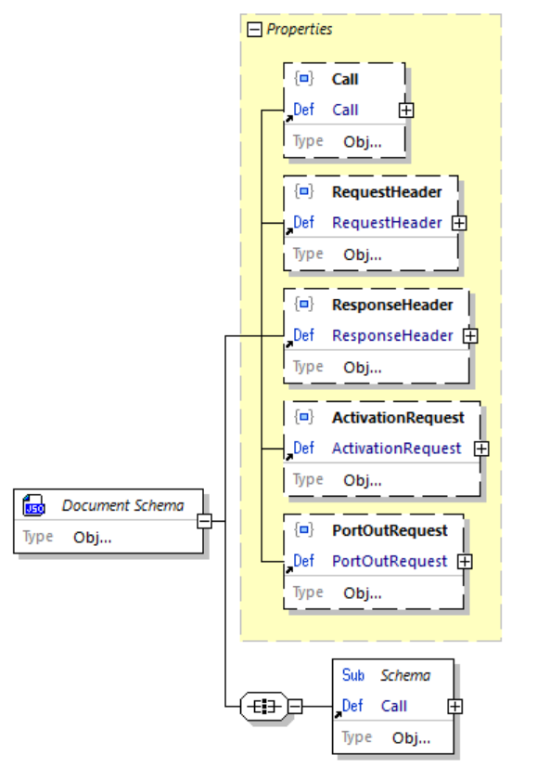
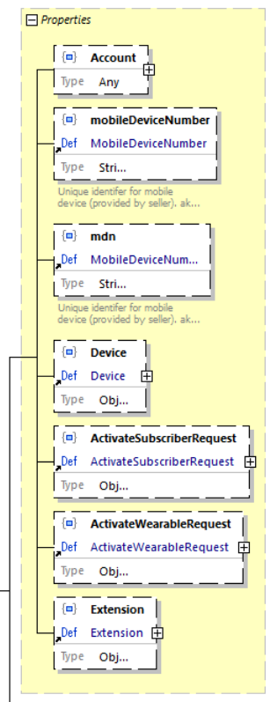
Data governance meets agile and micro services
Many tools are available for managing models, schemas and translating to and from Avro, JSON Schema and more.
Altova XML Spy (actually an excellent JSON Schema tool), Hackolade, etc.
"ActivationRequest": {
"billCycleDayOfMonth" : 15,
"Account": {
"type": "COMMERCIAL",
"billingSystemId": "amdocs",
"accountId": "987654321123456",
"BillingAddress": {
"lines": [
"123 Main Street",
"Apt 1A"
],
"postalCode": "00105",
"city": "Kansas City",
"state": "MO"
} ,
"Device": {
"deviceType": "IOS-10",
"deviceId": "123456789098765432122",
"Components": [
{
"type": "PSIM",
"iccid": "123456789012345"
}
]}…

Slide 11
Data governance meets agile and micro services
Questions and Discussion on JSON Schema, Tools, Standards

Slide 12
Data governance meets agile and micro services
Agile Development Teams
Focused on (almost exclusively) business function (stories).
Design (generally and of data structures) is not the focus.
Many use tools that generate the data model from code.
  Perceived efficiencies offset by excessive coding.
  Focus on code with idea to auto-document / link.
REST services are commonly put together using one example.
  Tools like Swagger and API Gateways support JSON Schema.
    Yet vast majority of Agile teams do not use schemas.
    Swagger is now compatible with OpenAPI spec v3.1+
      Supports JSON Schema v9+ (2020 etc)
    If JSON Schema used, interfaces are self-documenting.
    Available to QA groups, samples can be auto-generated.
Java code sample for one field:
@Size(
min = 5,
max = 14,
message = "The author email '${validatedValue}' must be between {min} and {max} characters long"
)
private String authorEmail;
The above multiplied one hundred times for one hundred fields. Then repeated for services that use the same data elements (usually with different rules between projects / teams).
Not reusable for different languages / platforms for the same data.

Slide 13
Data governance meets agile and micro services
Better Development with JSON Schemas
Just as with test-driven-development (TDD), data-driven development is faster/better/cheaper in the long run.
JSON Schema elements can be easily pulled together to create new ‘views’ of aggregates and denormalized elements as needed.
  This is the compromise : Allow teams to mix/match elements as needed to meet changing business needs.
  However, where truly new data elements or composites are created, work back through governance process (rarer case).
Allow teams to develop schemas from existing elements.
  Balance between governance and development speed.
  Restricting this creates bottleneck in development process.
  Data governance groups must be responsive to Agile sprints.
  Use an ‘extension’ (any) element to bridge the difference.
    Governance team reviews on periodic basis.
Java validation code (one time):
JSONObject jsonSchema = new JSONObject (
new JSONTokener(
JSONSchemaTest.class.getResourceAsStream(
"/schema.json")));
JSONObject jsonSubject = new JSONObject(
new JSONTokener(
JSONSchemaTest.class.getResourceAsStream(
"/product.json")));
Schema schema = SchemaLoader.load(jsonSchema);
schema.validate(jsonSubject);
The above sample loads the JSON Schema – just do once and keep in memory (faster).
Then for any data received, via any means, validate the payload against the schema.
  Process takes 10s of milliseconds.
Error handling is built-in (message auto-generated pointing to any errors).

Slide 14
Data governance meets agile and micro services
Questions and Discussion on Audience Dev Team Practices
Development Platforms
Languages / Frameworks
Process of Data Management

Slide 15
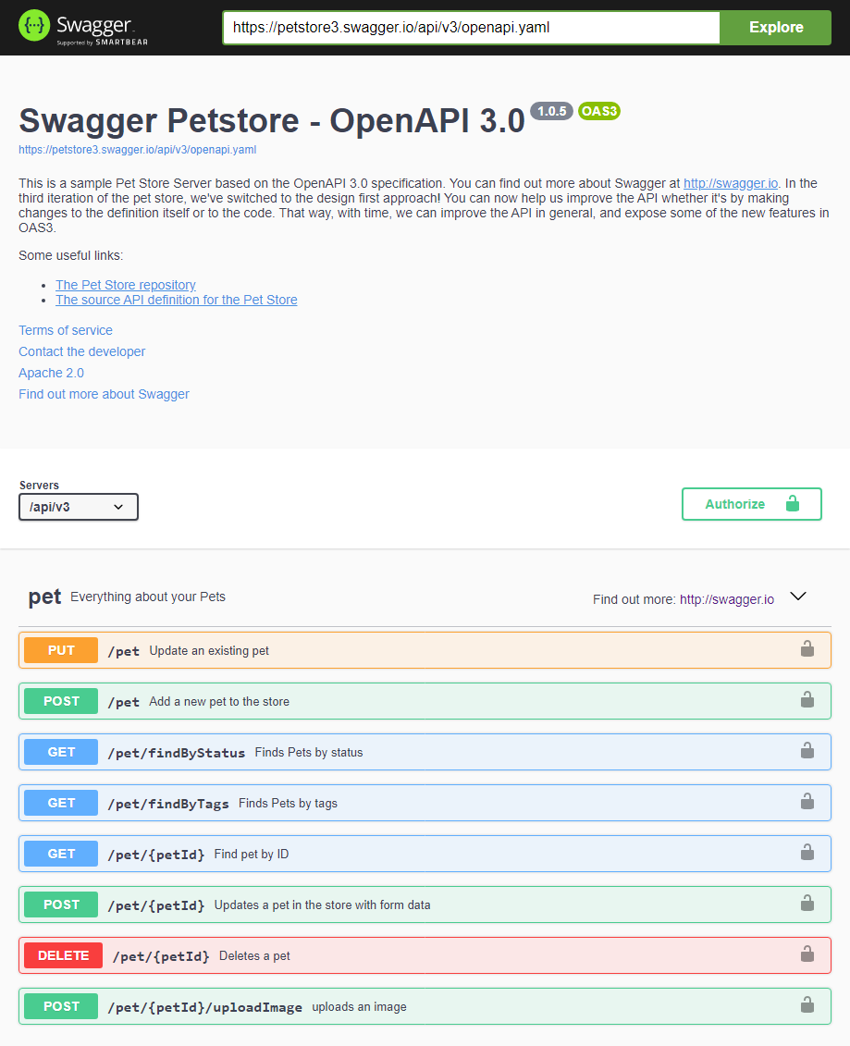
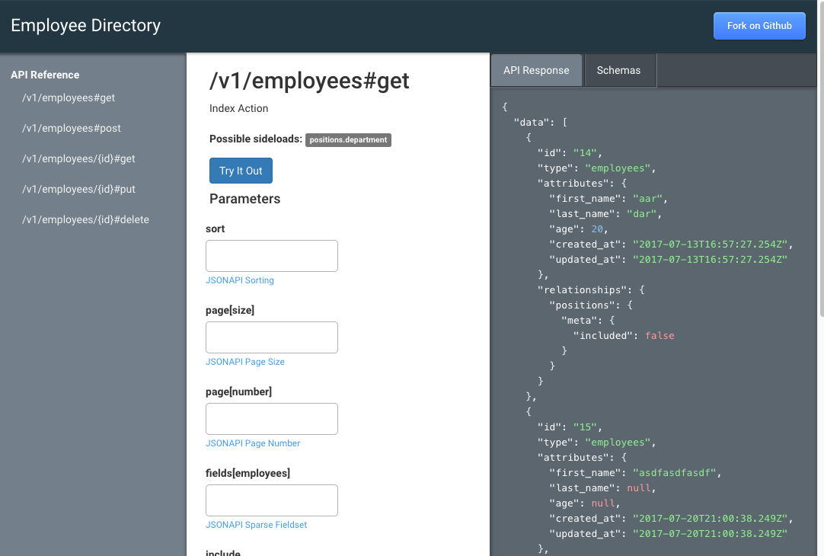
Data governance meets agile and micro services

Slide 16
Data governance meets agile and micro services
A Model for Maintaining JSON Schemas
JSON Schemas need to exist at 3+ levels:
  As discrete, reusable data elements:
    Ex: “addressLine” with min/max properties, etc.
  As small common components:
    Ex: “requestHeader” with meta-data, abstraction.
  As ‘documents’ or views at top-level.
  Ex: “PurchaseOrder” made up of components.
Denormalized single JSON Schema of the ‘document’ level, made up of the piece-parts available to teams.
Components and Documents must be versioned.
  Breaking-changes require new version!
  API versions tied to schema document versions.
Document
(v1.2)
Composite A
(v1.1)
Element 1
Element 2
Composite B
(v2.9)
Element 1
Element 5
Element 3

Slide 17



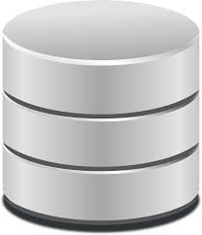

Data governance meets agile and micro services
A Model for Maintaining JSON Schemas
Data governance and development team collaboration.
  Data folks try to be responsive to business needs.
  Development folks try to reuse data elements.
  Meet to discuss changes.
    Development team can create new Documents and/or Composites where needed.
    Both groups check-in schemas, do versioning.
    Be careful of breaking changes!
  Use extensibility section (any) judiciously.
  Periodically meet and review new Documents and Composites – collapse and refine over time.
Data Mgmt
Developer
SCHEMA
JSON Schema Repository
JSON Schema
Web Server

Slide 18
Data governance meets agile and micro services
A Model for Using JSON Schemas
Once versioned JSON Schema are in a repository, they can be used by applications.
  Micro-services (language/platform neutral).
  Messaging systems (Kafka et al).
  Bulk data transfers.
Only use denomalized schema (one file – no external refs).
Applications load schemas into memory on startup.
Validation is done at run-time:
  Receiving POST requests from REST services.
  Receiving messages (Kafka) or data (sFTP etc).
REST API versioning associated with schema version.
  Ex: API v5 uses Product schema v6.1
Client / Publisher
Service / Receiver
validates
SCHEMA
(load on startup)
JSON Schema Repository
JSON Schema
Web Server

Slide 19
Data governance meets agile and micro services
Questions and Discussion on Audience Schema Management
Tools Used
Application Integration
Conversions from other formats (Avro, etc)

Slide 20
Data governance meets agile and micro services
A Model for Versioning
Documents are the top-level JSON Schema.
Documents are made up of any number of Components and individual Elements.
Components may contain other Components.
Components and Documents must be versioned.
Once published, versioned Schemas are immutable.
If a Component or Document has a required child (Element or Component) added, removed or renamed – that part version must be incremented. This may cascade:
  While the original Document version is unaffected, to use a new Component version the Document version must also be incremented.
Data Mgmt
Developer
Document
(v1.2)
Composite A
(v1.1)
Element 1
Element 2
Composite B
(v2.9)
SCHEMA
Element 1
Element 5
Element 3
JSON Schema Repository
JSON Schema
Web Server

Slide 21
Data governance meets agile and micro services
A Model for Versioning
REST API Version mapped 1-to-1 to Document Version.
The API payload (GET or POST) is part of the contract.
  Removing, adding or changing any Component or Element of the Document is a breaking change.
  Since the Document is the Payload … the version of the Document is linked to the REST API version.
    This is directly expressed in API documentation.
REST APIs usually include the version in the URL Path.
  Ex: GET /customer/v1
  where: “customer” is the top-level entity and “v1” is the version of the API, which corresponds to ‘some’ version of the Document schema… but need not be the same.
Client / Publisher
Service / Receiver
validates
Document
(v1.2)
Composite A
(v1.1)
Element 1
Element 2
SCHEMA
Composite B
(v2.9)
Element 1
(load on startup)
Element 5
Element 3
JSON Schema Repository
JSON Schema
Web Server

Slide 22
Data governance meets agile and micro services
Questions and Discussion on Schema and API Versioning
Strategies Used
Impact of using a single changing version
Minor / Major Version Naming Conventions

Slide 23

Data governance meets agile and micro services
Distributed computing, kafka, messaging and data
REST and Micro-Services have limits:
Many transactions require ordering.
  Ex: Connect/Disconnect in Cable Service.
Receiver must be available on sending.
  Round-robin availability breaks order.
One ‘event’, many possible recipients.
Each client/receiver interface is a project.

Slide 24
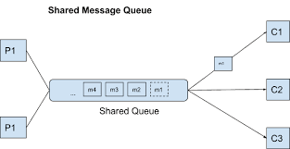
Data governance meets agile and micro services
Distributed computing, kafka, messaging and data
Kafka Basics:
Developed by LinkedIn originally (2010).
Moved to Apache Project (open source).
Made commercial by Confluent.
Highest performance in industry.
High-Availability built-in.
Guarantees unit-of-order (UOO).

Slide 25
Data governance meets agile and micro services
Distributed computing, kafka, messaging and data
3
Consumers load JSON Schemas from repository service.
1
Kafka guarantees that message is available to Consumers
2
Producer sends JSON that conforms to given schema.
4
Consumers receive messages in order, validate against schema.
SCHEMA

Slide 26

Data governance meets agile and micro services
Distributed computing, kafka, messaging and data
2
Producer sends JSON that conforms to given schema.
Producers load JSON Schemas from repository service.
1
SCHEMA

Slide 27
Data governance meets agile and micro services
Distributed computing, kafka, messaging and data
Questions and Discussion on Audience Use of Kafka
Projects / Examples
Message Payload Standards
JSON Schema Validation

Slide 28
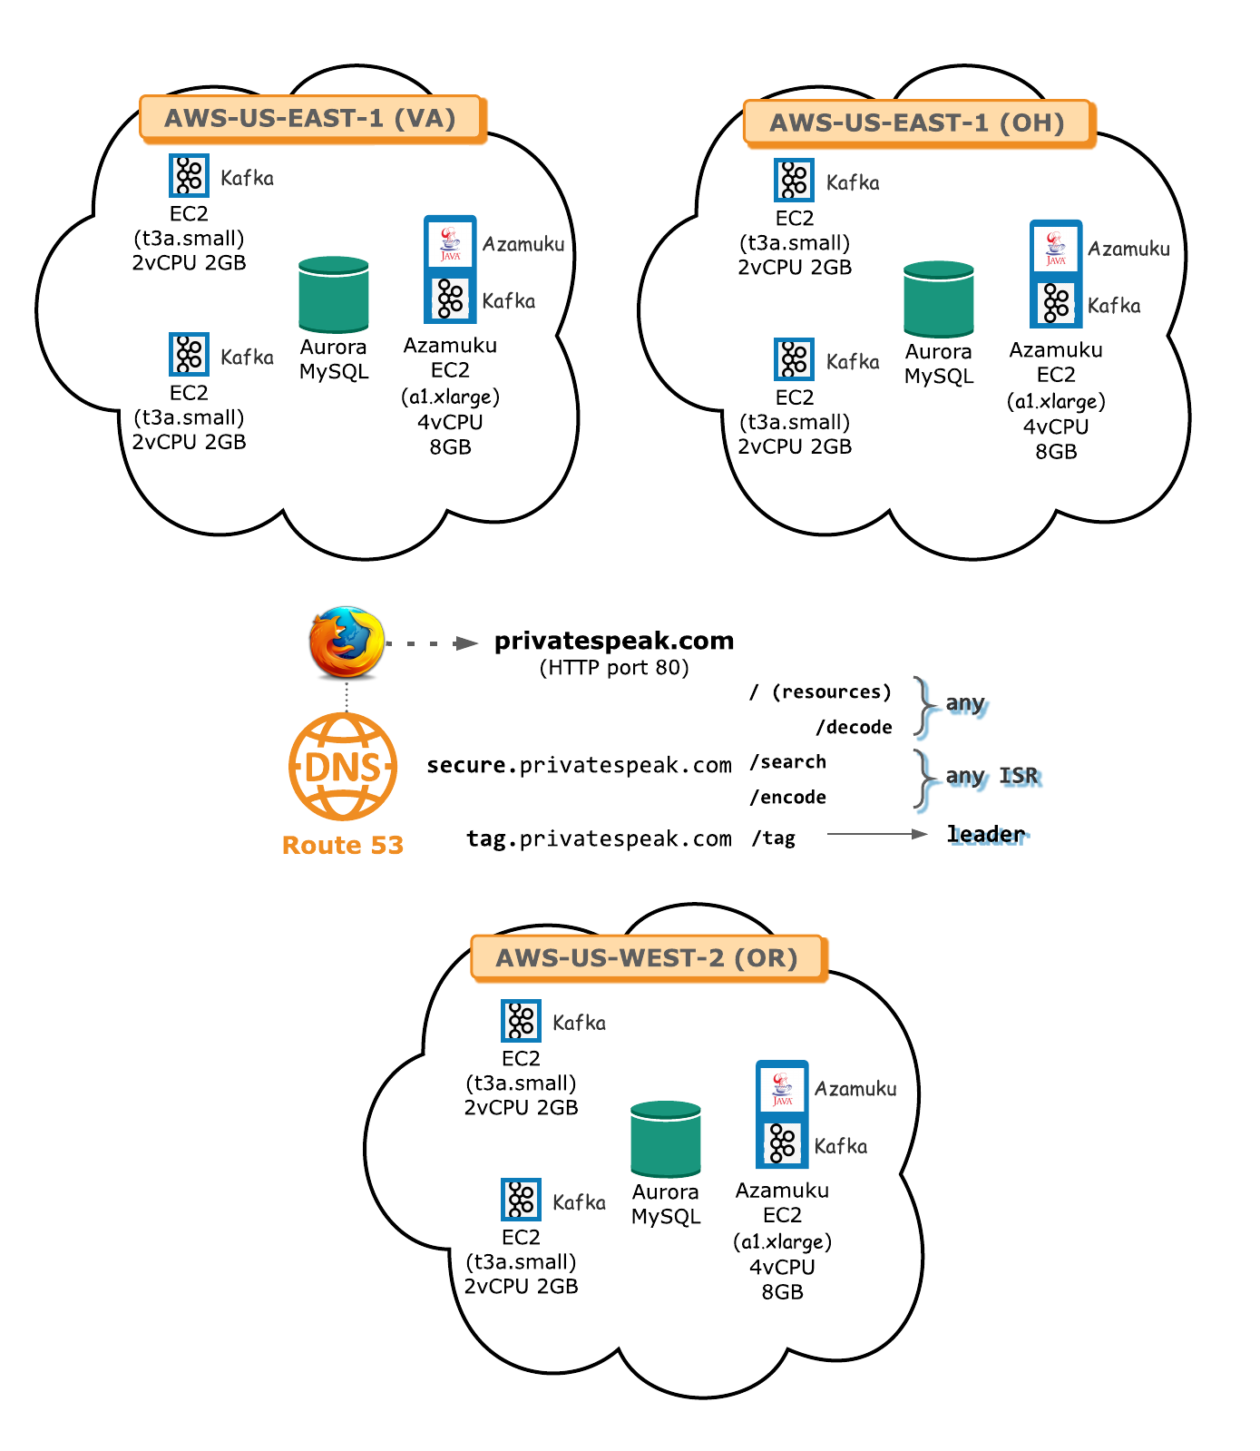
Data governance meets agile and micro services
Distributed computing, kafka, messaging and data
Case Study: Anatomy of Private Speak
  https://www.privatespeak.com
  Uses JSON Schema for all payloads.
  Validates every request against schema.
    No custom coding for message validation.
    Only good data allowed into system.
  Has both web-services and uses Kafka.
  Three databases in three regions – high availability.
    Synchronized via Subayai “Vital Plane” ™ framework.

Slide 29



Data governance meets agile and micro services
Putting it all together
KAFKA
High Availability, High Performance, Publish/Subscribe Events
(good for transactions)
REST-based, simple micro-services
(good for fetching data)
Schema Service
Managing Versioned Schemas
(+ documentation)
Versioned, Immutable and Reusable Documents and Components
JSON Schema Repository
Rich Language for describing data, min/max constraints, RegEx and reusability
SCHEMA

Slide 30
Data governance meets agile and micro services
Questions and Discussion with Audience On:
JSON Schema
REST APIs, Versioning and Schema Management
Kafka and Use-Cases

